Slide 1
DATA SCIENCE Phase 2 Project

Slide 2
TABLE OF CONTENTS
01
04
02
05
03
06
Introduction
Data Analysis
Objectives
Data Understanding
Models
Data Visualization
Conclusion
Recommendations
Next steps

Slide 3

The real estate agency
This project aimed to analyze the myriad factors that impact house prices within King County, with a particular focus on delivering accurate pricing estimates to both homeowners and potential buyers.
This project's outcomes aim to enhance transparency and knowledge within the King County housing market, ultimately benefiting all stakeholders in the real estate industry.

Slide 4
Objectives
The primary objective is to identify the locations within King County that exhibit the highest sales prices. This information is crucial for understanding where premium real estate properties are situated.
To explore how seasonal trends affect house sales, the project seeks to identify patterns and variations in property prices throughout the year. Understanding these trends can assist the real estate agency in optimizing their sales and marketing strategies.
Leveraging the relationships between various housing features and their impact on prices, the project aims to develop predictive models that can estimate house prices based on these attributes. These models will provide valuable insights for both sellers and buyers.

Slide 5
Data Understanding
Datasets: Kc house data and delivery location data (zip codes).
Null Values: We identified missing values .
Duplicates: No duplicates were found in the housing data.
Data Types: We converted the "date" column to a datetime data type.
Categorical Data: We converted categorical columns to numerical values.
Data Merging: We merged the two datasets using the common "zipcode" column.

Slide 6
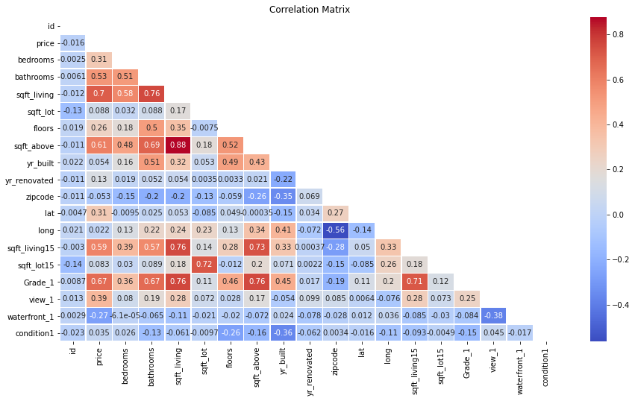
Data Visualization
A heatmap displaying the correlation matrix between features and the target variable ("price").

Slide 7
Correlation Matrix Summary
Features such as "sqft_living," "grade," and "bedrooms" show significant correlations with price.

Slide 8
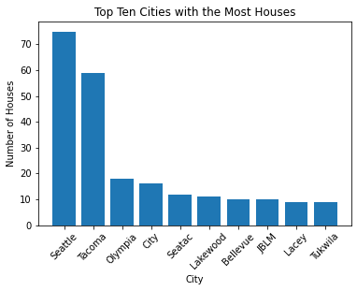
PRICE VS LOCATION
Seattle has the most houses
Tacoma is a close second

Slide 9
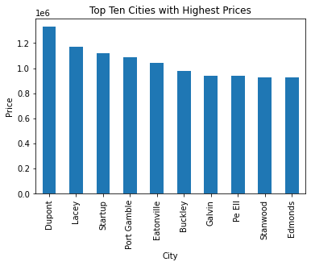
PRICE VS LOCATION
These cities have the most expensive houses.
Dupont has houses with the highest prices
Lacey is a close second

Slide 10
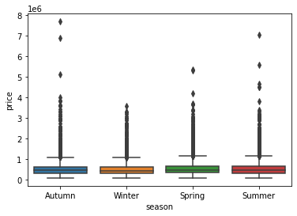
Seasonal Trends vs. Prices
Box plot presentation
Spring has the highest mean price
Winter has the lowest mean price

Slide 11
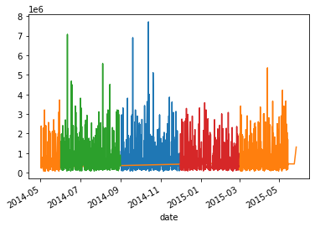
Seasonal trends vs. Prices
Time series plot
shows a continuous relationship of price over time.
Spring and Autumn have the highest sales prices

Slide 12
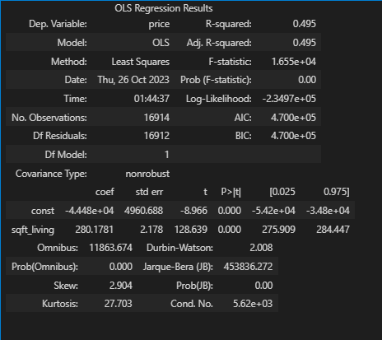
Baseline Model Results
The baseline model explained about 50% of the variance in price and the F-statistic p-value was below 0.05.
This showed a statistically significant relationship.

Slide 13
MAE
It measures the average absolute difference between the predicted values and the actual values
If the MAE is small, it means that the model's predictions are, on average, very close to the actual prices.
If the MAE is large, it suggests that the model's predictions deviate significantly from the actual prices.
Model 3 with an MAE of 141,592.73 is the best performing model among the ones we have evaluated in terms of its ability to make accurate price predictions.

Slide 14
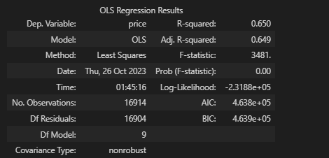
2nd Model Results
The second model explained about 65% of the variance in price and a MAE of 141592.73032447265, and 'MSE of 46826238256.493065,

Slide 15
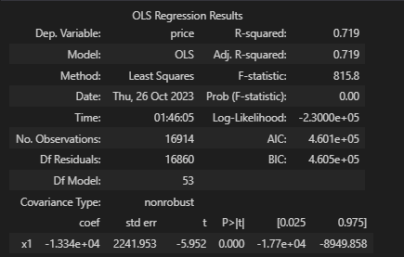
Polynomial Transformation of features
The second model explained about 72% of the variance in price.
The model has a MAE of 141,592.73 and is the best performing model among the ones we have evaluated in terms of its ability to make accurate price predictions.

Slide 16

Summary of the evaluation
The models that we have constructed has given us a more in depth understanding on the association of the various house features and the prices.
The model we finally came up with explains 72% proportion of the variance in the dependent variable (price) that is explained by the independent variables (features) in our regression model.

Slide 17

DATA PROJECT ARCHITECTURE
Objectives
Data
EDA
Decision
Modeling
Interpretation
Communication

Slide 18
Conclusion
The biggest contributors to pricing in a house is the square footage of the living space, square footage of the house excluding the basement and the grade of the house.

Slide 19
Limitations
1. Our analysis relied on two data sets. More data would have given us a further analysis.

Slide 20
Next steps
1. The agency should look for more data in regards to other
house features.
2. The agency should conduct surveys to look find specific factors that cause this seasonal variation so as to understand the market better.
3. The agency should conduct research to find location specific data, such as social amenities, neighborhoods and political stability to understand why certain areas command higher prices as compared to other

Slide 21
Recommendations
The agency should be on the lookout for features such as square footage of the living area, square footage above,when advising and valuing house for homeowners because they have strong correlations to price.

Slide 22
Recommendations
2. The agency should be on the lookout for houses in the areas: Seattle, Tacoma, Olympia, City, Seatac, Lakewood, Bellevue, JBLM, Lacey, Tukwila because they have the highest number of houses

Slide 23
Recommendations
3. When advising homeowners, the agency should be aware that the areas: Dupont, Lacey, Startup, Port Gamble and Eatonville.
4. The agency should be aware that the Spring season generally demands higher prices for the houses.
5. The agency should be aware that the Summer season generally demands lower prices for the houses.

Slide 24

Group Members
Sharon Kaliku
Ezra Kipchirchir
Paul Kamau
Heri Kimotho
Kipkosgei Kiptui

